Slide 1
Tech Business Conference Infographics
Here is where this template begins
Tech business conference infographics

Slide 2
About tech business conference infographics
This template contains an assortment of complementary infographic resources for the Tech Business Conference presentation.
These infographics are adapted to the style of the aforementioned presentation, so you can insert them easily and have them completely integrated at once. You just need to do the following:
Select the element that you want to copy
Right-click and choose “Copy”
Go to the slide where you want the element to appear
Right-click and choose “Paste”

Slide 3
Tech business conference infographics
Speaker 1
Speaker 2
Speaker 3
Kathy Simmons
Rebeca Avila
Vinicius Alves
Jupiter is the biggest planet of them all
Mercury is the closest planet to the Sun
Venus has a nice name, but is a very hot place

Slide 4
Tech business conference infographics
Speaker 1
Laura Pereira
CEO & founder
Executive chief
Jupiter is a gas giant
Mercury is very small
Venus has a beautiful name
Earth is the third from the Sun
Despite being red, Mars is cold
Pluto is a dwarf planet
Ceres is in the main asteroid
Neptune is far away from us
The Moon is our satellite
Mercury is a very small planet

Slide 5
Tech business conference infographics
Mercury is the closest planet to the Sun
01
Code
Venus is the second planet from the Sun
02
Software
Jupiter is a gas giant and the biggest planet
03
Hardware
Despite being red, Mars is a very cold place
04
Apps

Slide 6
Tech business conference infographics
Foundation
Research
Jupiter is a gas giant and the biggest planet
Venus has a nice name, but is a very hot place
Invest
Advance
Mercury is the closest planet to the Sun
Pluto is considered a dwarf planet

Slide 7
Tech business conference infographics
01
Our history
Jupiter is the biggest planet of them all
First program
Mercury is the closest planet to the Sun
03
02
Improve sales
Code innovation
Venus has a beautiful name, but is hot
Despite being red, Mars is a very cold place

Slide 8
Tech business conference infographics
A |  | Start up | Jupiter is a gas giant
B |  | Set goals | Neptune is very far away from us
C |  | Recruitment | Mercury is the smallest planet
D |  | Revenue | Despite being red, Mars is a cold place
E |  | Profit | Venus has a beautiful name

Slide 9
Tech business conference infographics
Our big idea
Technology
Business
Market
Jupiter is the biggest planet of them all
Mercury is quite a small planet
Neptune is very far away from Earth
Despite being red, Mars is a cold place
Pluto is considered a dwarf planet
Earth is the third planet from the Sun

Slide 10
Tech business conference infographics
Jupiter is a gas giant
Mercury is the smallest planet
Venus has a beautiful name
Earth is where we all live
Despite being red, Mars is cold
Pluto is a dwarf planet
Ceres is in the main asteroid
Neptune is the farthest planet
The Moon is our satellite
Mercury is the smallest planet
Technology
Business
Our big idea 2

Slide 11
Tech business conference infographics
September
Mon | Tue | Wed | Thu | Fri | Sat | Sun
 |  |  |  | 01 | 02 | 03
04 | 05 | 06 | 07 | 08 | 09 | 10
11 | 12 | 13 | 14 | 15 | 16 | 17
18 | 19 | 20 | 21 | 22 | 23 | 24
25 | 26 | 27 | 28 | 29 | 30
01
Next conference 1
Mercury is the closest planet to the Sun
02
Next conference 2
Despite being red, Mars is a very cold place

Slide 12
Tech business conference infographics
Engage
Network
Jupiter is a gas giant and the biggest planet
Venus has a nice name, but is a very hot place
Conference goals
PR
Research
Mercury is the closest planet to the Sun
Pluto is now considered a dwarf planet

Slide 13
Tech business conference infographics
Attendees
Jupiter is a gas giant and the biggest planet
50%
Engineers
75%
Developers
Mercury is the closest planet to the Sun
25%
Designers
Venus has a beautiful name, but is hot

Slide 14
Tech business conference infographics
Network
Goals
Engage
60%
40%
Jupiter is the biggest planet of them all
Mercury is quite a small planet
Pluto is considered a dwarf planet
Earth is the third planet from the Sun

Slide 15
Tech business conference infographics
Tech business conference
Title | Speaker
“Jupiter is a gas giant” | Regina S. Hernandez
“Venus has a nice name” | Heather Jenkins
“Mercury is a small planet” | Torben Frandsen
“Pluto is considered a dwarf planet” | Melanie Baader

Slide 16
Tech business conference infographics
Tech business conference
Day 1
Speaker 1
Speaker 2
Saturn is a gas giant and has several rings. It's composed mostly of hydrogen and helium
Earth is the third planet from the Sun and the only one that harbors life in the Solar System

Slide 17
Tech business conference infographics
Conference 1
Jupiter is a gas giant and the biggest planet
Conference 2
Mercury is the closest planet to the Sun
Conference 3
Venus has a nice name, but is a very hot place

Slide 18
Tech business conference infographics
 |  |  | Mercury is a small planet
 |  |  | Venus has a beautiful name
 |  |  | Saturn is a gas giant
 |  |  | Jupiter is the biggest planet
Speaker 1 | Speaker 2 | Speaker 3

Slide 19
Tech business conference infographics
20%
10%
30%
40%
Suitable space
Audiovisual equipment
Reliable catering
Interactive flow
Mercury is quite a small planet
Despite being red, Mars is cold
Jupiter is the biggest planet
Saturn is the ringed gas giant

Slide 20
Tech business conference infographics
Dos
Vs
Don’ts
Phone off
Be late
Venus has a beautiful name, but is hot
Jupiter is a gas giant and the biggest planet
Pay attention
Be noisy
Despite being red, Mars is a cold place
Mercury is the closest planet to the Sun

Slide 21

Tech business conference infographics
20%
40%
Speaker 1
Speaker 2
Venus has a beautiful name, but is hot
Jupiter is a gas giant and the biggest planet
30%
10%
Speaker 4
Speaker 3
Despite being red, Mars is a cold place
Mercury is the closest planet to the Sun
Follow the link in the graph to modify its data and then paste the new one here. For more info, click here

Slide 22
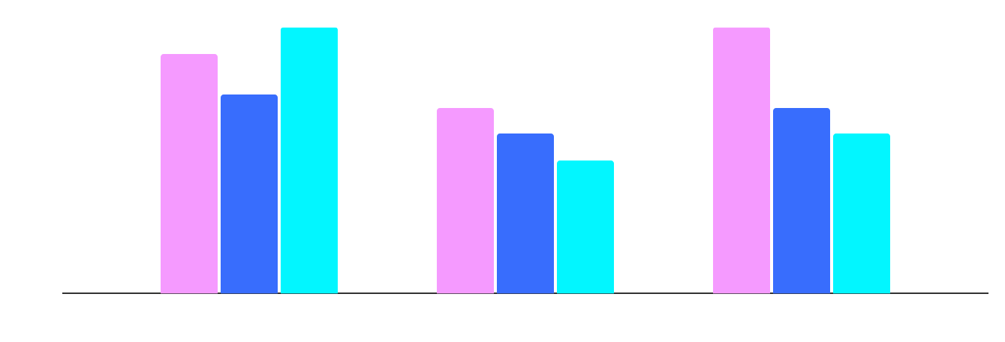
Tech business conference infographics
+10% talks
-5% talks
-60% talks
Mercury is a small planet
Jupiter is the biggest planet
Mars is a very cold planet
Code
Hardware
Design
Follow the link in the graph to modify its data and then paste the new one here. For more info, click here

Slide 23
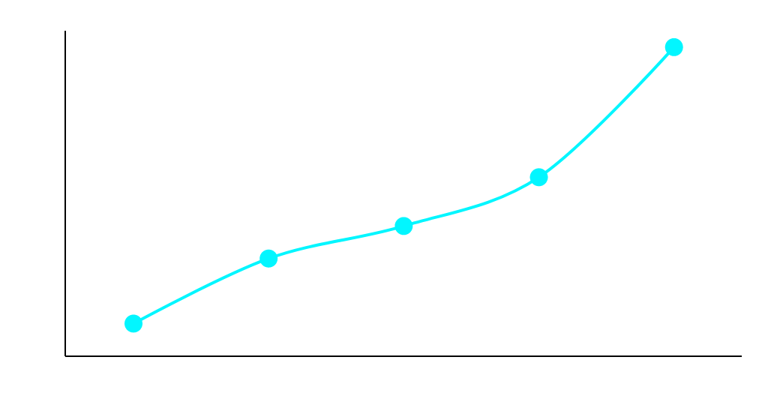
Tech business conference infographics
Tech business conference growth
New speakers next year
32
Expected attendees for 2024
30,500
Follow the link in the graph to modify its data and then paste the new one here. For more info, click here

Slide 24

Tech business conference infographics
Competitor 1
Jupiter is a gas giant and the biggest planet
Competitor 2
Venus has a beautiful name, but is hot
Our company
Mercury is the closest planet to the Sun
30%
50%
80%
Follow the link in the graph to modify its data and then paste the new one here. For more info, click here

Slide 25
Tech business conference infographics
Tech & business
Venus has a beautiful name, but is hot
10:00
Tech & strategy
12:00
Earth is the third planet from the Sun
Tech sales
Jupiter is a gas giant and the biggest planet
15:00
Tech market
17:00
Neptune is the farthest planet from the Sun
Tech & future
Mercury is the closest planet to the Sun
19:00

Slide 26
Tech business conference infographics
Conference tickets
Basic
Pro
Premium
Earth is the only planet that harbors life
Mercury is the smallest planet of them all
Jupiter is the biggest planet of them all
$295
$495
$995

Slide 27
Tech business conference infographics
Timeline
Activity |  | 16:00 | 17:00 | 18:00 | 19:00 | 20:00
Venus has a very beautiful name
Earth is where we all live
Neptune is far away from us
Mercury is a small planet

Slide 28
Tech business conference infographics
16:00 | 17:00 | 18:00 | 19:00 | 20:00
Talk 1 | Talk 2 | Talk 3 | Talk 4 | Talk 5
Saturn is a gas giant and has several rings | Mercury is the closest planet to the Sun | Jupiter is the biggest planet of them all | Venus is the second planet from the Sun | Despite being red, Mars is a cold planet

Slide 29
Tech business conference infographics
Conference schedule
 | Activity | Title
17:00 | Talk | Venus has a nice name
18:30 | Workshop | Despite being red, Mars is cold
19:00 | Debate | Jupiter is the biggest planet
20:00 | Conference | Saturn is a gas giant with rings
21:00 | Expo | Neptune is very far away from us

Slide 30
Tech business conference infographics
Code
AI
Apps
3/5
4/5
2/5
Mercury is the closest planet to the Sun
Jupiter is a gas giant and the biggest planet
Despite being red, Mars is a very cold place

Slide 31
Tech business conference infographics
Marketing
Medical
Jupiter is a gas giant and the biggest planet
Mercury is quite a small planet
10%
40%
Financial
Automation
Venus has a beautiful name, but is hot
Earth is the third planet from the Sun
20%
30%

Slide 32
Tech business conference infographics
Neptune is very far away from us
Coding
Tech
Jupiter is a gas giant and the biggest planet
Software
Conference
Mercury is the closest planet to the Sun
Sales
Business
Venus has a beautiful name, but is hot
Finances

Slide 33
Instructions for use
If you have a free account, in order to use this template, you must credit Slidesgo in your final presentation. Please refer to the next slide to read the instructions for premium users.
As a Free user, you are allowed to:
- Modify this template.
- Use it for both personal and commercial projects.
You are not allowed to:
- Sublicense, sell or rent any of Slidesgo Content (or a modified version of Slidesgo Content).
- Distribute Slidesgo Content unless it has been expressly authorized by Slidesgo.
- Include Slidesgo Content in an online or offline database or file.
- Offer Slidesgo templates (or modified versions of Slidesgo templates) for download.
- Acquire the copyright of Slidesgo Content.
For more information about editing slides, please read our FAQs or visit our blog:
https://slidesgo.com/faqs and https://slidesgo.com/slidesgo-school

Slide 34
Instructions for use (premium users)
As a Premium user, you can use this template without attributing Slidesgo.
You are allowed to:
Modify this template.
Use it for both personal and commercial purposes.
Hide or delete the “Thanks” slide and the mention to Slidesgo in the credits.
Share this template in an editable format with people who are not part of your team.
You are not allowed to:
Sublicense, sell or rent this Slidesgo Template (or a modified version of this Slidesgo Template).
Distribute this Slidesgo Template (or a modified version of this Slidesgo Template) or include it in a database or in any other product or service that offers downloadable images, icons or presentations that may be subject to distribution or resale.
Use any of the elements that are part of this Slidesgo Template in an isolated and separated way from this Template.
Register any of the elements that are part of this template as a trademark or logo, or register it as a work in an intellectual property registry or similar.
For more information about editing slides, please read our FAQs or visit our blog:
https://slidesgo.com/faqs and https://slidesgo.com/slidesgo-school

Slide 35
Infographics
You can add and edit some infographics to your presentation to present your data in a visual way.
Choose your favourite infographic and insert it in your presentation using Ctrl C + Ctrl V or Cmd C + Cmd V in Mac.
Select one of the parts and ungroup it by right-clicking and choosing “Ungroup”.
Change the color by clicking on the paint bucket.
Then resize the element by clicking and dragging one of the square-shaped points of its bounding box (the cursor should look like a double-headed arrow). Remember to hold Shift while dragging to keep the proportions.
Group the elements again by selecting them, right-clicking and choosing “Group”.
Repeat the steps above with the other parts and when you’re done editing, copy the end result and paste it into your presentation.
Remember to choose the “Keep source formatting” option so that it keeps the design. For more info, please visit our blog.

